Slide 1
IOT BASED MANHOLE DETECTION AND
MONITORING SYSTEM
UNDER THE GUIDANCE OF :Dr.K.KAMAKSHAIAH
DONE BY :
MADA SAI KIRAN

Slide 2

CONTENTS
Abstract
Existing System
Proposed System
System configuration
System Architecture
System Design
Advantages
Disadvantages
Literature survey
Sample Prototype
Sample Code
Output Screens
References
Conclusion

Slide 3
ABSTRACT
A smart city is the future goal to have cleaner and better amenities for the society. Smart underground infrastructure is an important feature to be considered while implementing a smart city. Drainage system monitoring plays a vital role in keeping the city clean and healthy. Since manual monitoring is incompetent, this leads to slow handling of problems in drainage and consumes more time to solve. To mitigate all these issues, the system using a wireless sensor network, consisting of sensor nodes is designed. The proposed system is low cost, low maintenance, IoT based real time which alerts the managing station through message when any manhole crosses its threshold values. We use API with embedded C as the source and platform for developing the project. This system reduces the death risk of manual scavengers who clean the underground drainage and also benefits the public.​

Slide 4
EXISTING SYSTEM
The existing drainage monitoring system is not automated . Therefore, when a jam occurs, it is difficult to determine the exact location of the jam.
There is also no early fall warning. Therefore, it takes a long time to identify and eliminate the blockage.
It became very uncomfortable.
Deal with the situation where the pipeline is completely blocked. People have a big problem due to the failure of the drain pipe.

Slide 5
PROPOSED SYSTEM
An underground drainage monitoring system will not only help in maintaining the proper health and safety of the city but also in reducing the work of government personnel.
Various types of sensors (flow, level, temperature and gas sensors) are interfaced with microcontroller Arduino Uno in order to make the system smart. When the respective sensors reach the threshold level, the indication of that respective value and sensor is being sent to the microcontroller.
The Furthermore, Arduino Uno then sends the signal and location of the manhole to the municipal corporation through GSM and GPS and the officials could easily locate which manhole is having the problem and could take appropriate steps.
Also, Arduino Uno updates the live values of all the sensors in the manholes falling under the respective area using IoT. A message will also be displayed on the LCD.

Slide 6
SYSTEM CONFIGURATION
Software Requirements:
Arduino IDE
Windows OS
EMBEDDED C
Hardware Requirements:
Power supply
Arduino
SIM8008(GSM module)
LCD
LED
DC Motor
Sensors( water , gas ,tilt , temperature)
Mobile Phone

Slide 7
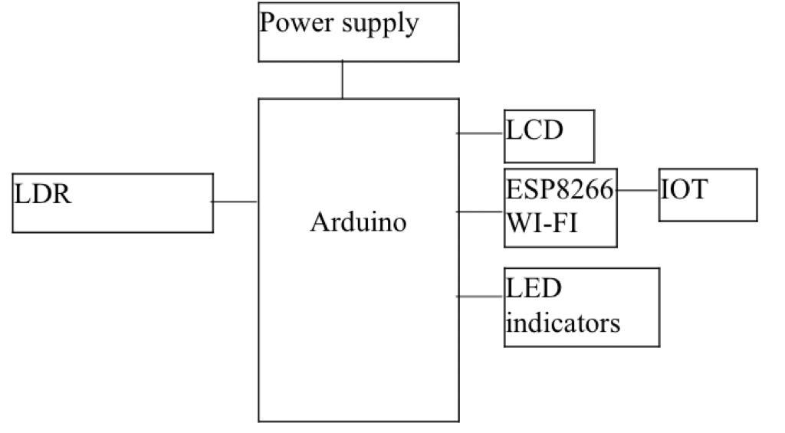
SYSTEM ARCHITECTURE

Slide 8
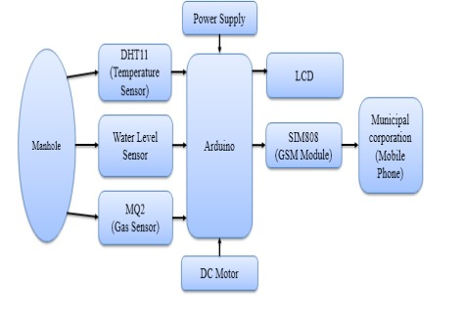
SYSTEM DESIGN

Slide 9
ADVANTAGES
Detect the location
The system governing the flow of sewage from the pipes.
Use of flow sensors to detect the variations in the flow.
Get the prior alerts of blockages and locate them using IOT.
Trace location using GPS and send SMS through GSM.

Slide 10
DISADVANTGES
All the sensors in the manhole should be regularly monitored.
Proper power supply should be maintained for the system to be active.
The transmission of data to the cloud may be delayed due to signal jamming, hence , the system must be monitored on regular basis.

Slide 11
LITERATURE SURVEY
In the recent past, wireless sensor networks have found their way into a wide variety of applications and systems with vastly varying requirements and characteristics.
As a consequence, it is becoming increasingly difficult to discuss typical requirements regarding hardware issues and software support.
This is particularly problematic in a multidisciplinary research area such as wireless sensor networks, where close collaboration between users, application domain experts, hardware designers, and software developers is needed to implement efficient systems.
In this project, we discuss the consequences of this fact with regard to the design space of wireless sensor networks by considering its various dimensions.
We justify our view by demonstrating that specific existing applications occupy different points in the design space.

Slide 12
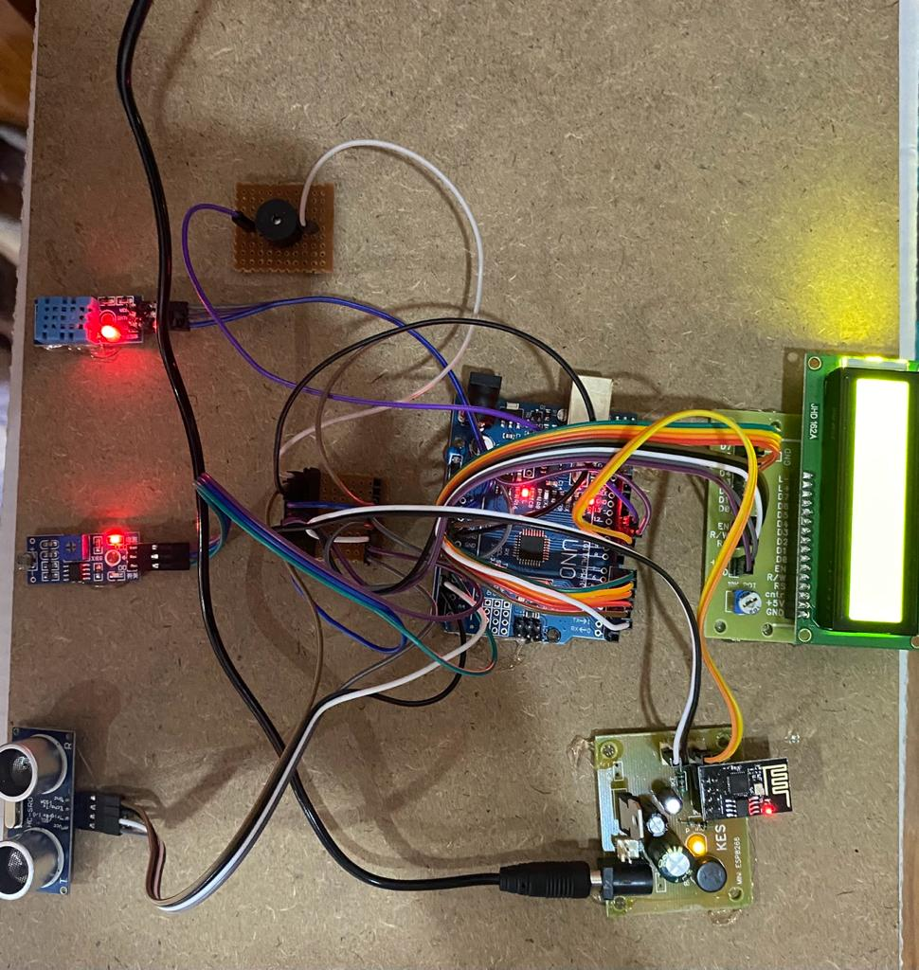
SAMPLE PROTOTYPE

Slide 13
SAMPLE CODE
#include <LiquidCrystal.h>
LiquidCrystal lcd(2, 3, 4, 5, 6, 7);
#include <SoftwareSerial.h>
#include <dht11.h>
#define RX 9
#define TX 10
#define dht_apin 11 // Analog Pin sensor is connected to dht11 dhtObject;
nt sensorPin = A0;
#define trigger A1
#define echo A2int sensorValue = 0;
int led = 12;
String AP = "elegant"; // AP NAMEString PASS = "smartwork"; // AP PASSWORDString API = "KA5N7CVOXCUBVBWW"; // Write API KEY 9EWU4V8S8ECXFQUXString HOST = "api.thingspeak.com";

Slide 14
SAMPLE CODE
String PORT = "80";int countTrueCommand;
int countTimeCommand;
boolean found = false;
int valSensor = 1;
float time=0,
distance=0;
SoftwareSerial esp8266(RX,TX);
void setup()
{
lcd.begin(16, 2);
lcd.clear();
lcd.print("IOT BASED MANHOLE");

Slide 15
SAMPLE CODE
lcd.setCursor(0, 1);
lcd.print(" MONITORING");
delay(1000);
pinMode(led, OUTPUT);
pinMode(trigger,OUTPUT);
pinMode(echo,INPUT);
Serial.begin(9600);
esp8266.begin(115200);
sendCommand("AT",5,"OK");
sendCommand("AT+CWMODE=1",5,"OK");
sendCommand("AT+CWJAP=\""+ AP +"\",\""+ PASS +"\"",20,"OK");
}

Slide 16
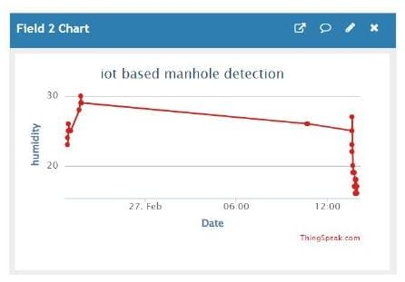
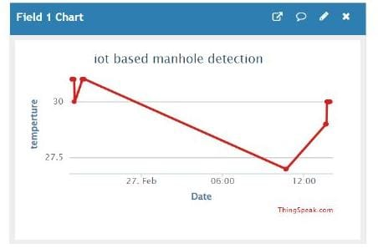
OUTPUT SCREENS

Slide 17
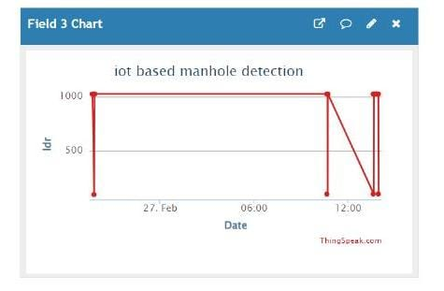
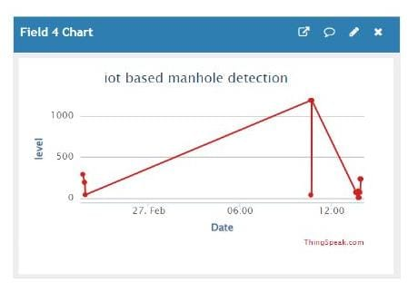
OUTPUT SCREENS

Slide 18
REFERENCES
[1] S Sultana, A Rahaman, AM Jhara, AC Paul “An IOT Based Smart Drain Monitoring System with Alert Messages”-Conference on Intelligent, 2020 Springer.
[2] A Pendharkar, J Chillapalli, K Dhakate, “IoT Based Sewage Monitoring System”, Available at SSRN, 2020, researchgate.net.
[3] U Andrijašević, J Kocić, V Nešić, “Lid Opening Detection in Manholes” 2020 - ieeexplore.ieee.org.
[4] P Bhosale, “Iot Based System for Detection of Sewage Blockages”, 2021, it-in-industry.org.
[5] M Aarthi, A Bhuvaneshwaran, “Iot Based Drainage and Waste Management Monitoring and Alert System for Smart City”- Annals of the Romanian Society, 2021 - annalsofrscb.ro.

Slide 19
CONCLUSION
Underground monitoring is challenging problem. This project proposes different methods for monitoring and managing underground drainage system. It explains various applications like underground drainage and manhole identification in real time. Various parameters like temperature, toxic gases, flow and level of water are being monitored and updated on the internet using the Internet of Things. This enables the person in-charge to take the necessary actions regarding the same. In this way the unnecessary trips on the manholes are saved and can only be conducted as and when required. Also, real time update on the internet helps in maintaining the regularity in drainage check thus avoid the hazards.

Slide 20
THANK YOU

